Slide 1
Angular CLI
Building Unit and End to End Tests
Lecture 7
By James(Jin) Wang
11/28/2021

Slide 2
Outline
Execute unit tests
Watch for file changes
Execute end to end tests
Explore the various options

Slide 3
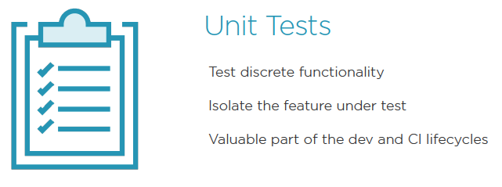
Testing Angular

Slide 4
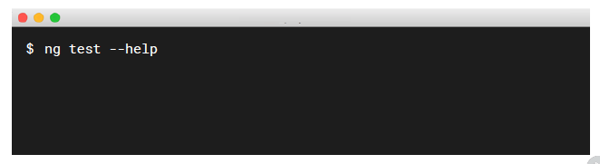
Testing Angular
  Getting Help:
  Add the --help or -h flag

Slide 5
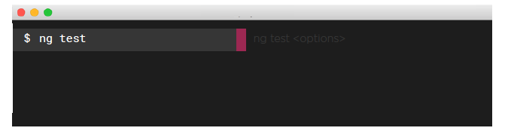
Testing Angular
  Test During Development:
  Execute tests on all *.spec.ts files
  Watch for file changes, then test again
  Run in its own terminal process
  Demo: ng test

Slide 6
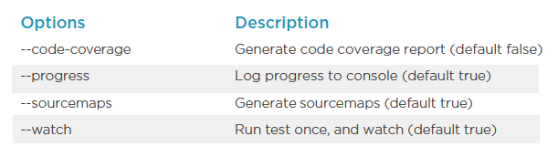
Testing Options
  Common ng test Options:

Slide 7
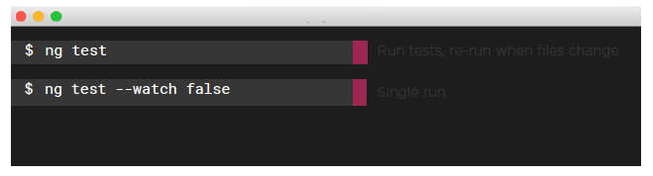
Testing Options
  Continuous Testing vs Single Test Cycle:
  Tests execute after a build is executed via Karma
  Automatically watch your files for changes, by default with ng test
  Run a test a single time with ng test --watch false

Slide 8
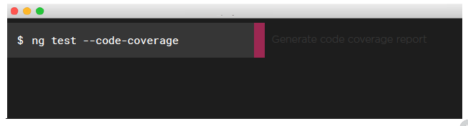
Testing Options
  Test Code Coverage:
  Calculate and report test code coverage with ng test --code-coverage
  Report is generated in the /coverage folder
  Report folder is configurable in karma.conf.js

Slide 9
Demo
  ng test --code-coverage
  ng test

Slide 10
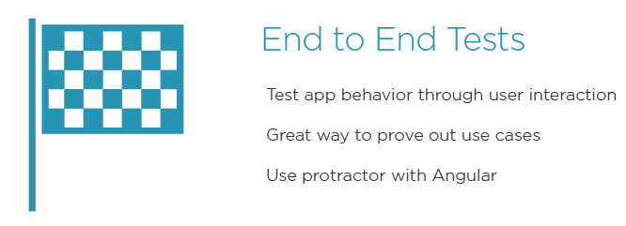
End to End Tests

Slide 11

End to End Tests
  Getting Help:
  Add the --help flag

Slide 12
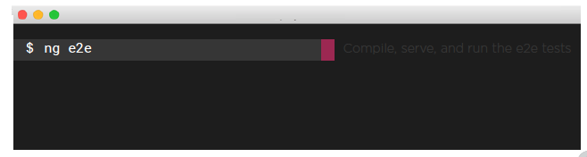
End to End Tests
  ng e2e:
  By default it compiles, serves on a random port, and runs tests
  Executes end-to-end tests
  Demo: ng e2e

Slide 13
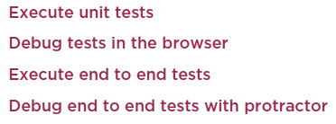
Summary

